Slide 1
BUSINESS VENTURES AND OWNERSHIP
{JUMPING INTO BUSINESS MARKETPLACE HEAD FIRST}

Slide 2
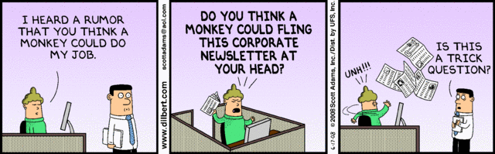
BUSINESS OWNERSHIP

Slide 3
BUSINESS OWNERSHIP
Forms of Legal Ownership
  Sole proprietorship
    Owned and operated by one person
  Partnership
    Sole proprietorship multiplied by the number of partner-owners
  Corporation

Slide 4
SOLE PROPRIETORSHIPS
Advantages:
  Freedom
  Simple to form
  Low start-up costs
  Tax benefits
  Formation of cooperatives
Disadvantages:
  Unlimited liability:
    Owners are responsible for all debts of a business
  Limited resources
  Limited fundraising capability
  Lack of continuity

Slide 5
PARTNERSHIPS
Advantages:
  More talent and money
  More fundraising capability
  Relatively easy to form
  Limited liability for limited partners
  Tax benefits
Disadvantages:
  Unlimited liability for general partner
  Disagreements among partners
  Lack of continuity

Slide 6
ALTERNATIVES TO GENERAL PARTNERSHIPS
Limited Partnership
  Allows for limited partners who invest money but are liable for debts only to the extent of their investments
  Must have at least one general (or active) partner, who is usually the person who runs the business and is responsible for its survival and growth
Master Limited Partnership
  Organization sells shares (partnership interests) to investors on public exchange. Investors are paid back from profits
  The master partner retains at least 50 percent ownership and runs the business, while minority partners have no management voice

Slide 7

COOPERATIVES
Combine the freedom of sole proprietorships with the financial power of corporations
Groups of sole proprietorships or partnerships agree to work together for their common benefit

Slide 8
CORPORATIONS
Corporation
  Firms that have filed papers of incorporation
Corporations may:
  Be small or large
  Sue and be sued
  Buy, hold, and sell property
  Make and sell products
  Commit crimes and be tried and punished for them
  Have limited liability for individuals who form them

Slide 9

ZAPPOS BILLION DOLLAR GENIUS CEO

Slide 10
CORPORATIONS
Advantages:
  Limited liability:
    The owners’ responsibility for the debts of a business is limited to their investment in a business
  Continuity
  Stronger fundraising capability
  Professional management
Disadvantages:
  Double taxation of dividends
  Fluid control (tender offer)
  Complicated and expensive to form
  Heavy regulations
  Complex legal requirements

Slide 11
TYPES OF CORPORATIONS
Closely Held (Private) Corporation vs. Publicly Held (Public) Corporation
  C Corporation (C Corp)
  Subchapter S Corporation
  Limited Liability Corporation (LLC)
  Professional Corporation
  Multinational (Transnational) Corporation
  Benefit Corporation (B Corp)

Slide 12
MANAGING A CORPORATION
Corporate Governance
  The roles of shareholders, directors, and other managers in corporate decision making and accountability
  Corporate governance is established by the firm’s bylaws and involves three bodies:
    Stockholders (shareholders): Investors who buy ownership shares in the form of stock
    The board of directors: Group elected by stockholders to oversee corporate management
    Corporate officers: Top managers hired by the board to run the corporation

Slide 13

STOCKHOLDERS: OWNERS OF CORPORATIONS
Stock: A share of ownership in a corporation
Dividends: Profits distributed among stockholders

Slide 14
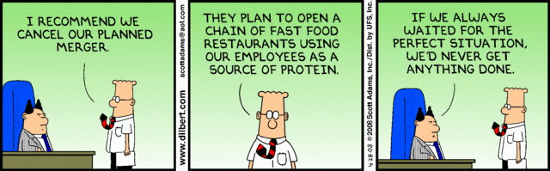
BUSINESS VENTURES

Slide 15
SPECIAL ISSUES IN CORPORATE OWNERSHIP
Joint Ventures and Strategic Alliances:
  Strategic alliance: Two or more organizations collaborate on a project for mutual gain
  Joint venture: Partners share ownership of a new enterprise
Employee Stock Ownership Plans
  Allows employees to own a share of the corporation through trusts established on their behalf
Institutional Investors
  Control enormous resources and can buy huge blocks of stock

Slide 16
SPECIAL ISSUES IN CORPORATE OWNERSHIP
Mergers, Acquisitions, Divestitures, and Spin-Offs:
  Merger: Two firms combine to create a new company
  Acquisition: One firm buys another outright
  Divestiture: Strategy whereby a firm sells one or more of its business units
  Spin-off: A firm sells part of itself to raise capital
    Divisions of companies that then become independent businesses with assets, employees, intellectual property, technology, or existing products that are taken from the parent company.
    Shareholders of the parent company receive equivalent shares in the new company in order to compensate for the loss of equity in the original stocks

Slide 17
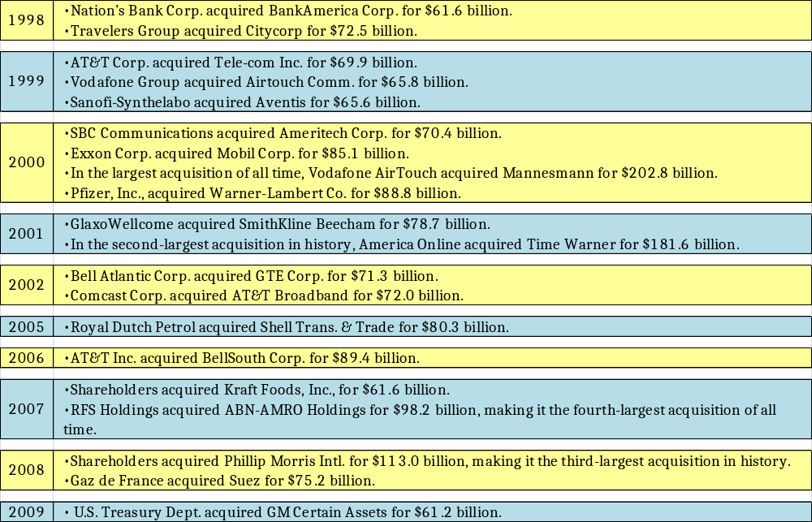
LARGEST MERGERS & ACQUISITIONS IN HISTORY

Slide 18
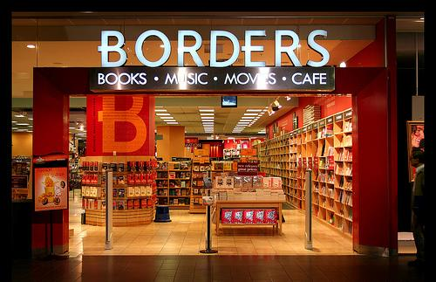
THE DEMISE OF A GIANT

Slide 19
BORDERS – THE DEMISE OF A GIANT
Former type: Public (OTCBB: BGPIQ)
Industry: Retail (Specialty)
Fate: Liquidation
Founded: 1971 (Tom and Louis Borders )
Defunct: 2011
Headquarters: Ann Arbor, Michigan, U.S.
Products: Books, Maps, CDs, DVDs, Calendars, Zunes, Gift Packs, Magazines, Board Games, Encyclopedias
Revenue: $2.8 billion USD (2009) (down from 2008)
Employees: app. 19,500 (2010)
Subsidiaries: Waldenbooks

Slide 20
BORDERS – THE DEMISE OF A GIANT
Borders started as a small business in Ann Arbor, MI with 1 store and a handful of employees
  Sold a meager stock of used books and textbooks
Today, Borders was an internationally recognized, publically-traded company with revenues in the billions of dollars
The last time Borders made a profit was 2006
  Yearly income has dropped by $1 billion in the four years since then
November 2009, Borders announced closing of 200 stores
February 2011, Borders filed for bankruptcy
July 2011, Borders booksellers to be liquidated (sold off in pieces)
  11,000 employees to lose their jobs
  Close remaining 399 stores with a phased roll-out by the end of September

Slide 21
BORDERS – THE DEMISE OF A GIANT
What happened?
  Some experts claim Borders "lost its edge" in the mid-1990s.
    Borders went heavy into CD music sales and DVD, just as the industry was going digital
    Borders expanded its physical plant, refurbished its stores and outsourced its online sales operation to Amazon
      Failed to develop its own e-reader (Kobo was not a Borders product) or increase online presence and sales
    Failed to keep up with the changes in the publishing industry
With Borders gone, does this new market availability make room for small business booksellers to succeed or does it indicate the end of brick-and-mortar bookstores?

Slide 22
QUESTIONS OR CLARIFICATIONS?

